Slide 1
2024 Tuxedo Town and Village Updates
& Clean Energy Communities

Slide 2
Two Programs:
Climate Smart
and
Clean Energy Communities
Climate Smart Program administered by NYS DEC
- Actions include: Greenhouse Gas Inventories; Climate Mitigation; Clean Energy; Recycling
- Certification achieved after 120 points
- Certification leads to eligibility for grants
Clean Energy Program administered by NYSERDA
- Actions include: Clean Energy Upgrades and Community education
- Certification achieved after 4 High Impact Actions
- Certification Award: $5000
- Additional awards based on which actions are adopted
The NYSERDA Coordinator assists municipalities with their goals of certification for both Programs.

Slide 4
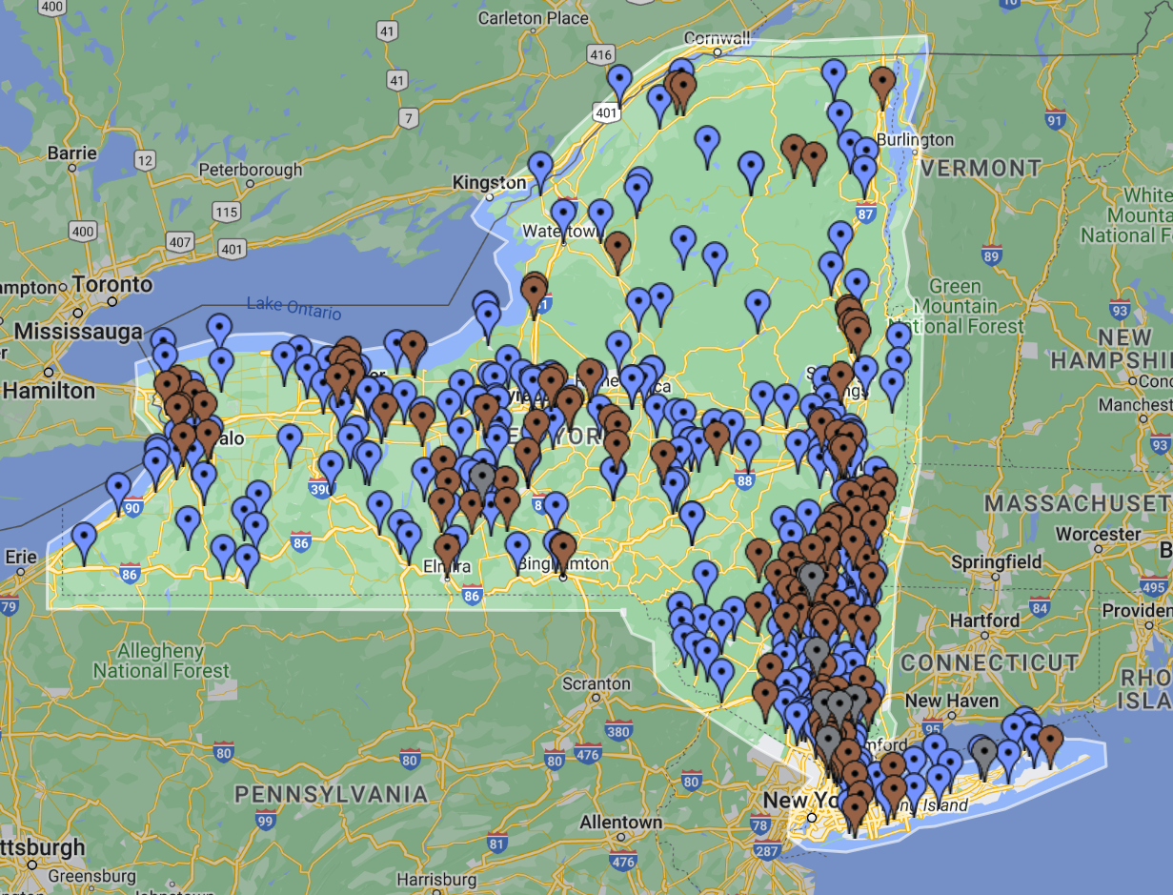
Registered Bronze Certified Silver Certified

Slide 5
Tuxedo and
Tuxedo Park
Climate Smart Community
Task Force
Adoption of the Climate Smart Pledge
Formation of a Task Force, a “CSC Committee”
Goals of the CSC Committees
Each governing Board approves Actions based on Committee recommendations.
Joint meetings of the two CSC Committees
The Zoom link for the monthly meeting is posted on the Town’s website.
Agendas and Minutes will be posted on a Climate Smart tab on the Town’s website.
Monthly meetings with the Orange County CSC Task Force and our NYSERDA Coordinator, Eleanor Peck.
Committee Members attend Regional Conferences and Webinars.
Notes:
Both Tuxedo and Tuxedo Park have adopted the Climate Smart Pledge and have formed a Task Force, a “CSC Committee”
Goals of the CSC Committees work with each governing Board toward certification in both Climate Smart and Clean Energy Programs.
The two CSC Committees meet jointly on the first Monday of the month to share information that helps each municipality achieve certification.
The Committee Chairs meet monthly with the Orange County CSC Task Force, which is part of the Orange County Planning Department, and with our NYSERDA Coordinator, Eleanor Peck

Slide 6
Committee Members
Tuxedo Committee Members
-Michele Lindsay, Chair
-Peter Gmelch
- Bill Lemanski, Town Planning Board Member
-Natalia Trujillo
Tuxedo Park Committee Members
-Jim Hays, Chair
-Josh Scherer, Village Trustee
-John Ledwith, Village Building Inspector
-Diana Larsen
-Fred Buell

Slide 7
Town of Tuxedo
Climate Smart
Community
Actions and Points
2019 - 2023
-Adopted CSC Pledge and Formed CSC Task Force: 20 points
-Appointed CSC Coordinator/Chair: 10 points
-Joined efforts with Tuxedo Park: 3 points
- LED Streetlight Conversion: 12 points (CEC points: 900)
- Energy Code Enforcement Training: 5 points
- Unified Solar Permit: 5 points
- Town Hall Energy Audit with Daylight: 10 points for audit of 25% of buildings
- Compost bin sales and education: 2 points
- Community Choice Aggregation (In progress)
Potential CSC: 27 points
- Recycling Program (In progress)
Potential CSC: 5 points
POINTS needed for Certification: 120
POINTS to DATE: 67
Potential additional points in progress: 32

Slide 8
Optional Additional Actions for 2024
For Climate Smart certification
21 additional points needed
1.Government Greenhouse Gas Emissions Inventory
16 points
https://climatesmart.ny.gov/actions-certification/actions/#open/action/6
2. Energy Benchmarking of Municipal Buildings over 1000 square feet
4 points
Complete CEC Benchmarking Action https://climatesmart.ny.gov/actions-certification/actions/#open/action/43
3. Upgrade Interior Lighting
Up to 5 points depending on % of lighting upgraded
https://climatesmart.ny.gov/actions-certification/actions/#open/action/13
4. HVAC Upgrade
2 points
https://climatesmart.ny.gov/actions-certification/actions/#open/action/14

Slide 9
Town of Tuxedo
Progress and
Challenges
-Expect to achieve NYSERDA Clean Energy Community certification before DEC Climate Smart certification
-Community Choice Aggregation (CCA) is on hold as the current prices Joule (the Administrator) can offer in the contract are not economically attractive; will repeat education campaign
-Town Board approval required to complete Actions
-Approval from Town Board needed for temporary personnel to assist with prepare documentation and communication (Community Campaign, CCA)
-Town Board support needed for Committee Volunteers to lead and complete major projects:
*Community Campaigns; CCA; Greenhouse Gas Inventories
-Recycling action needs to be adopted by Town Board as part of: Employee Manual; cleaning contracts; event and recreation contracts

Slide 10
Town of Tuxedo
Clean Energy Community
Completed and
Planned Tasks for 2024
LED Streetlight conversion completed: 700 points earned
Energy Code Enforcement Training: 200 points earned
-Work with the Town Board to complete actions for NYSERDA Clean Energy Community certification. Options include:
LED Decorative Lights conversion Powerhouse Parking Lot
200 points
Community Choice Aggregation Program
500 points
Renewable Energy: Subscribe Municipal Accounts to Community Solar
300 points
Community Campaigns: Promote opportunities for Community Solar, Clean Heating and Cooling, and Electric Vehicles
900 points
Benchmarking: Set up a System to measure and share energy use info in municipal buildings
300 points
Municipal Fleet Inventory
200 points

Slide 11
Community Campaigns Grants to Promote
Community Solar, Clean Heating and Cooling,
and Electric Vehicles
Community Solar Campaign
Achievement Level L1 L2 L3
Sign Ups 10 50 100
Points 200 300 500
Grant $5,000 $10,000 $20,000
Clean Heating and Cooling Campaign
Installations 5 10 15
Points 500 600 700
Grant $5,000 $10,000 $20,000
Electric Vehicle Campaign
Purchases 5 15 50
Points 200 300 500
Grant $5,000 $7,500 $15,000

Slide 12
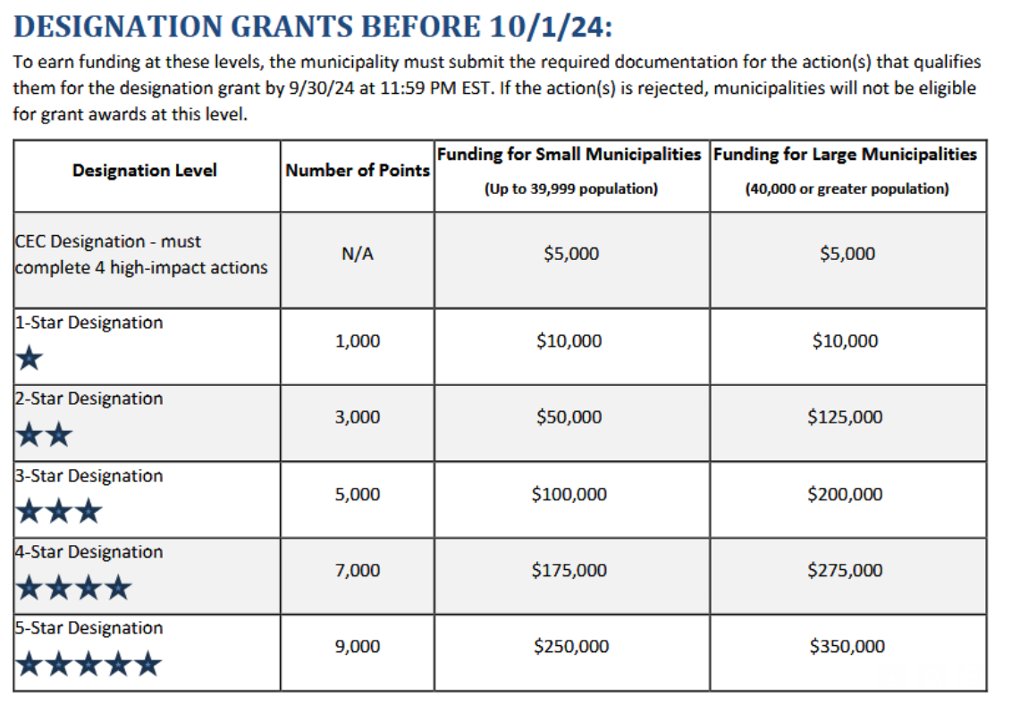
Award
Possibilities
Prior to 10/1/24

Slide 13
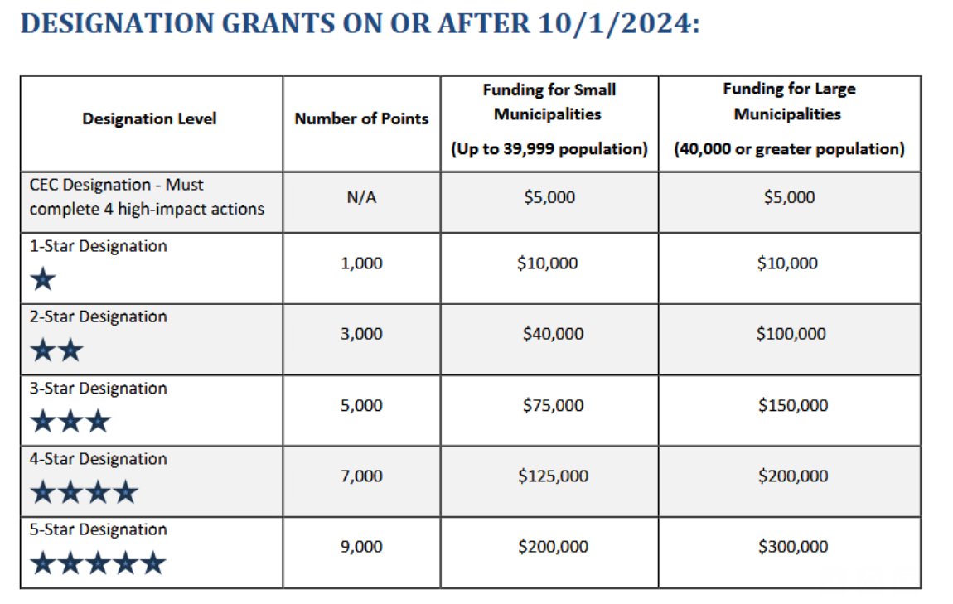
Award
Possibilities
After
10/1/24

Slide 14
CEC Point Estimator
Community Name: Town of Tuxedo
Potential 2024 Points 2400
Current Points 900
Total Potential 2024 Points 3300
Potential Grants $80,000

